Slide 1


Embracing Agile way of working

Slide 2
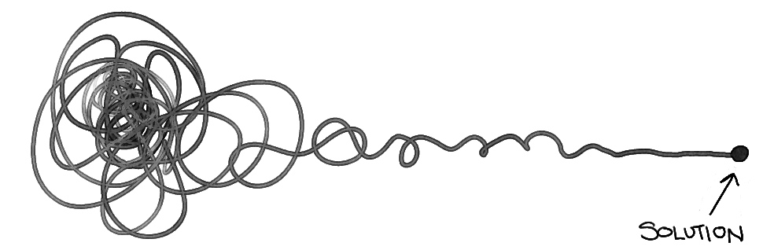
How might we respond to change and uncertainty?
Notes:
In a world of increasing market volatility, shorter product life cycles, higher product complexity, and global supply chains, Adient must grow both the culture and capabilities to become more flexible and responsive to business trends and demand changes.
This the only way we can consistently deliver on our strategic business goals as outlined in our 5 Year Marker.
Across the organization we’re starting to explore how technology accelerators like Industry 4.0 and advanced Analytics can help us digitize our production cycle and effectively use data from product development, services and manufacturing to accelerate decision making, increase efficiency and lead to faster product improvements.
To do this we need to change more than just the way we deliver. We need to encourage a mindset that promotes a culture of collaboration, adaptability, engagement and accepting (and leveraging) uncertainty.
That is why we’ve started this Agile journey and developed a framework to help Adient define and deliver value faster to our stakeholders.

Slide 3
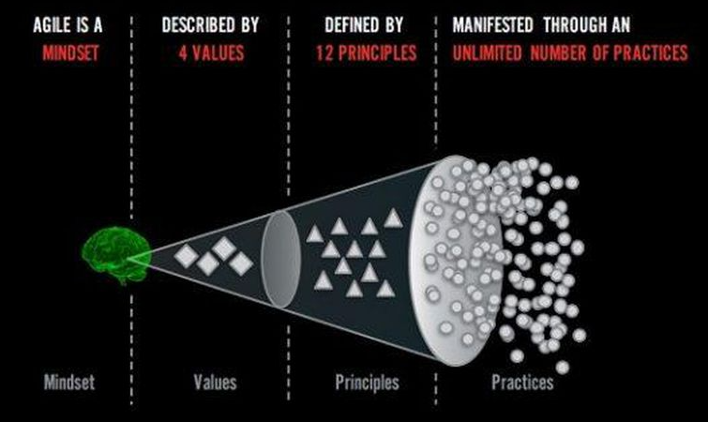
What is Agile?
Ref: Adopted from Ahmed Sidky
Notes:
Agile is a MINDSET described by Values defined by PRINCIPLES and manifested through many different practices

Slide 4
Agile Mindset
A mindset is an established set of attitudes. It is our consciousness, our way of being, how we behave and what we value. It is our organizational culture.
The Agile Mindset emphasizes:
Expect and embrace change
Focus on rapid value delivery – identify the most important thing and get it done
When in doubt, defer decisions to the last responsible moment
Get started as quickly as possible and learn as we go – inspect and adapt
Only do what is needed and no more – the simplest thing
Organize work so we get working product into the hands of our customer as quickly as possible – focus on incremental, iterative development
Organize the work to leverage the power of collaborating teams

Slide 5
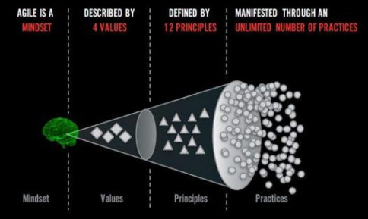
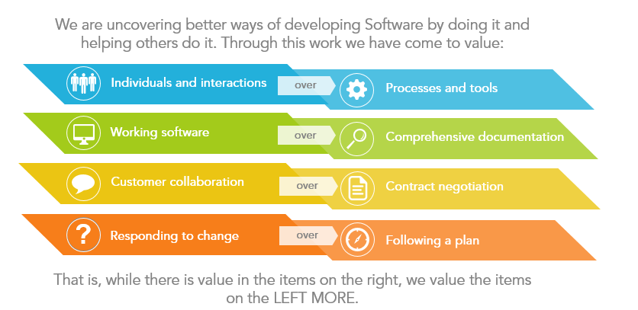
Four Values
value over
value over
value over
value over
While we recognize the value of the items on the right, we value the items on the left more.
Ref: https://agilemanifesto.org
Notes:
Max

Slide 6
Twelve Principles
01 Our highest priority is to satisfy the customer through early and continuous delivery of valuable software.
02 Welcome changing requirements, even late in the development. Agile processes harness change for the customer’s competitive advantage.
03 Deliver working software frequently, from a couple of weeks to a couple of months, with a preference to the shorter timescale.
04 Business people and developers must work together daily throughout the project.
05 Build projects around motivated individuals. Give then the environment and support they need, and trust them to get the job done.
06 Agile processes promote sustainable development. The sponsors, developers and users should be able to maintain a constant pace indefinitely.
07 Working software is the primary measure of progress.
08 The most efficient and effective method of conveying information to and within a development team is face-to-face conversation.
09 Continuous attention to technical excellence and good design enhances agility.
10 Simplicity – the art of maximizing the amount of work not done – is essential.
11 The best architecture, requirements and designs emerge from self-organizing teams.
12 At regular intervals the team reflects on how to become more effective, then tunes and adjusts its behavior accordingly.
Ref: https://agilemanifesto.org

Slide 7
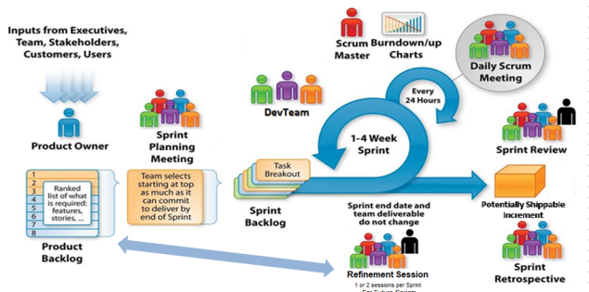
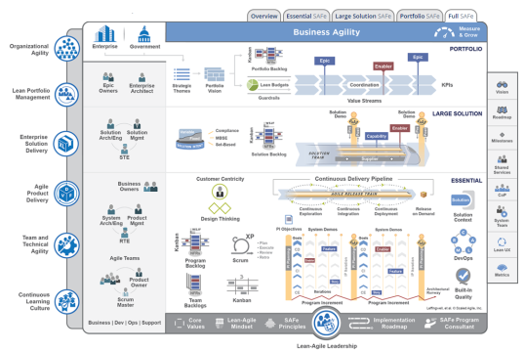
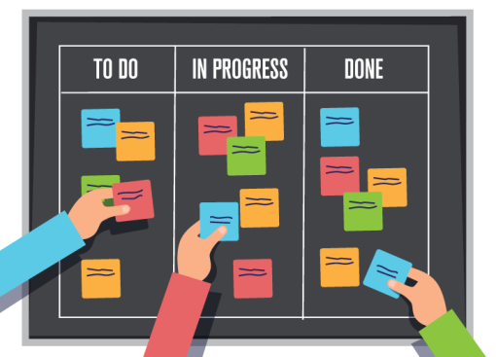
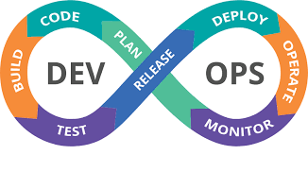
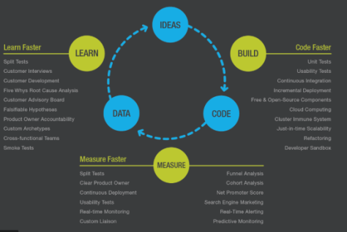
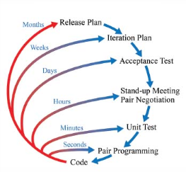
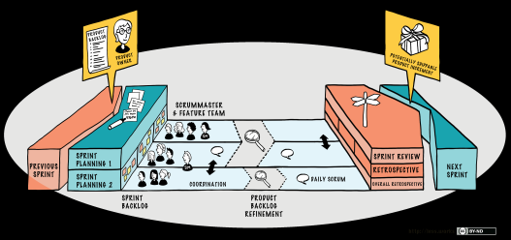
Unlimited Practices
https://www.scrum.org/resources/scrum-guide
https://www.scaledagileframework.com
https://less.works
http://www.extremeprogramming.org

Slide 8

“Great leaders GIVE CONTROL. They don’t take control. ”
- Capt. David Marquet
Book: Turn the Ship Around! A True Story of Turning Followers Into Leaders
https://www.youtube.com/watch?v=ivwKQqf4ixA
Notes:
Play video:
https://www.youtube.com/watch?v=OqmdLcyES_Q

Slide 9
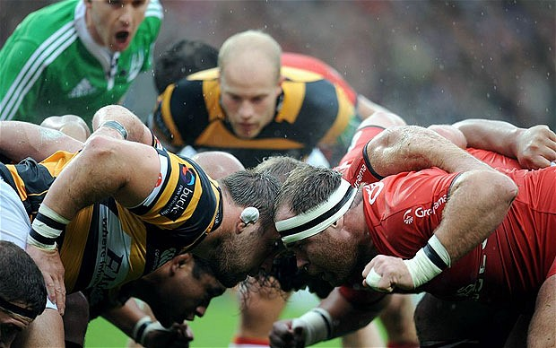
Scrum
https://www.scrum.org/resources/scrum-guide

Slide 10
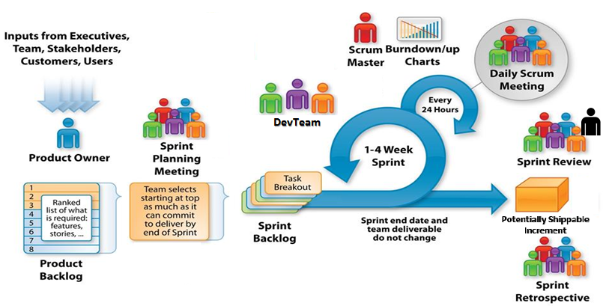
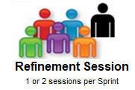
Scrum
For Future Sprints
Adapted from: http://csharpcorner.mindcrackerinc.netdna-cdn.com/UploadFile/BlogImages/11292015063901AM/SystemsPlus-Scrum-Image-.jpg

Slide 11
Why Scrum?
A process framework that relies on inspect and adapt cycles to incorporate changes in requirements and reduce overall risk
Delivers business functionality in two weeks
A transparent approach for technical and business to have an ongoing conversation
Improved quality of delivery due to collaboration of business & technical teams, shorter feedback cycles, and continuous adoption of contemporary engineering practices
Easy to understand and few teams are already embracing it

Slide 12
Business and Delivery teams interaction
TO DO
Attach a doc with samples
Requirements in Epic-Feature-Story format
Continuous interaction of business and delivery teams
Often and shorter UAT (e.g. every 6 to 8 weeks for a week)
Availability of Ambassador env. (pre UAT and available to select few Business team members to have access to new and chick functionalities)

Slide 13
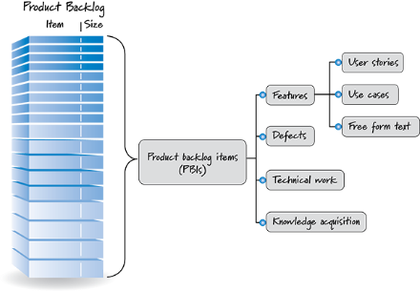
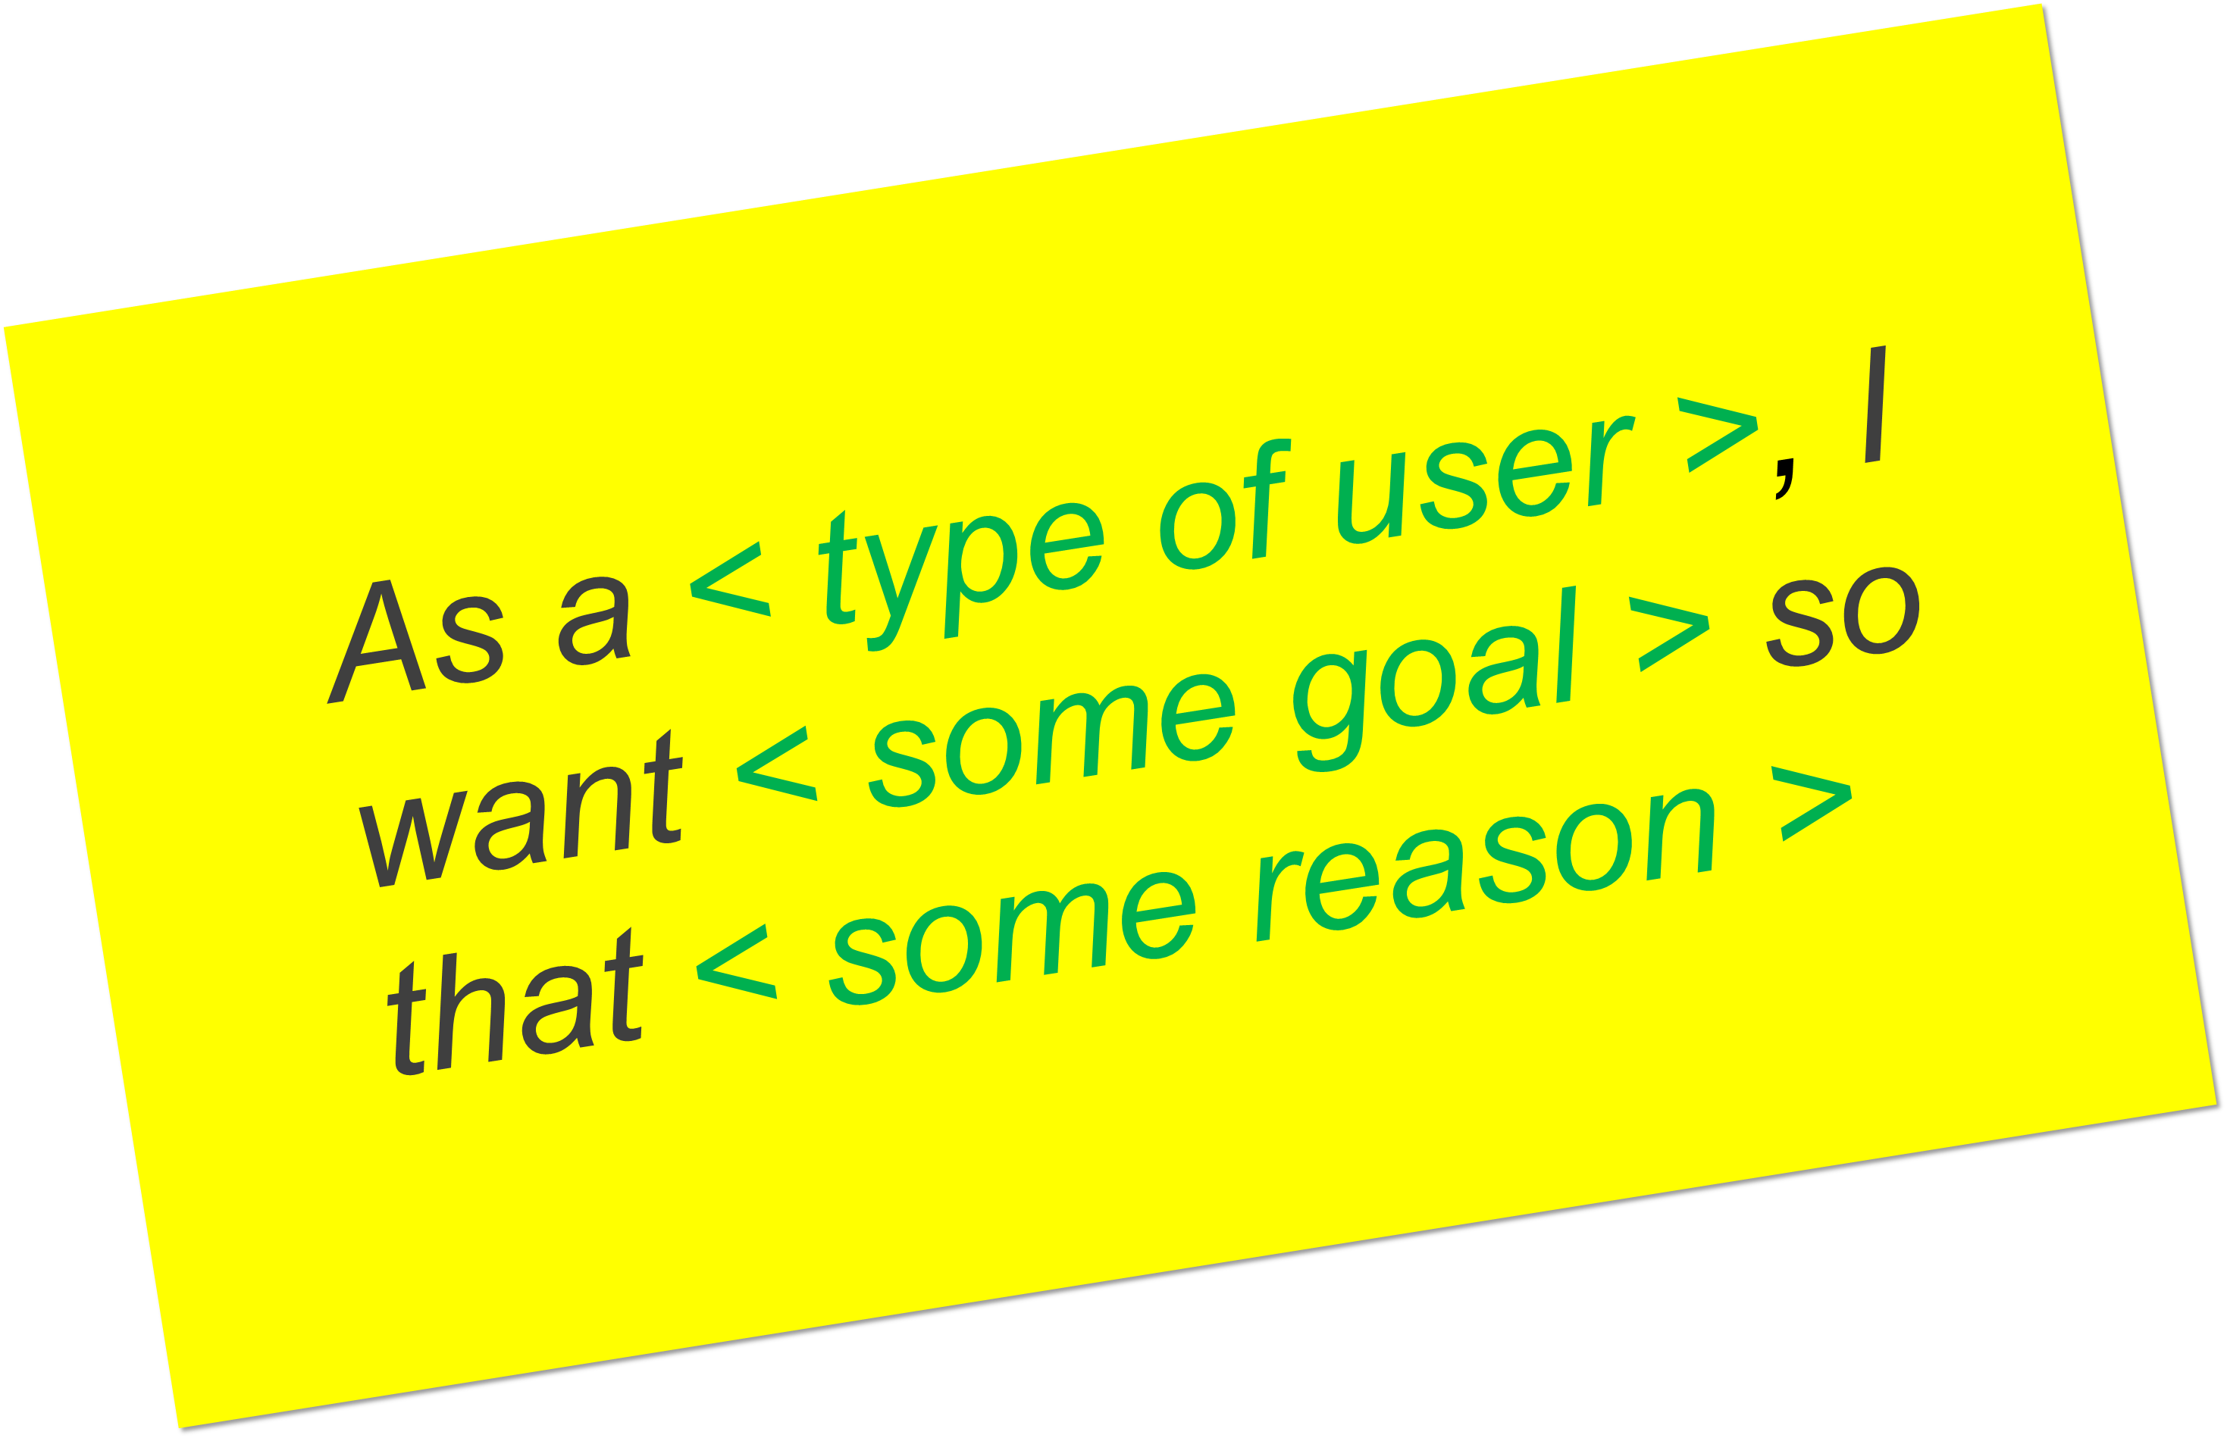
Healthy Product Backlog
User Story 1
User Story 2
Feature 1
User Story 3
Epic 1
Feature 2
User Story 4
Feature 3
Product Backlog Items (PBIs)
Product Backlog Items include business backlog items and end-user functionality as well as nonfunctional technical enabler stories - technical work items that are created to support the development of the business initiatives
Epic 2

Slide 14
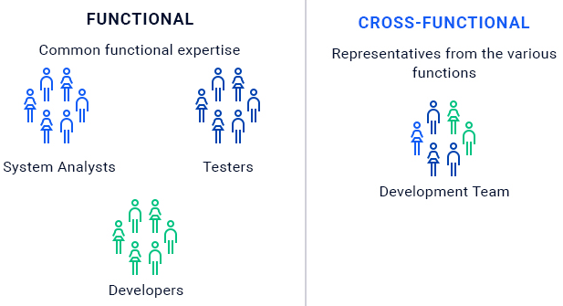
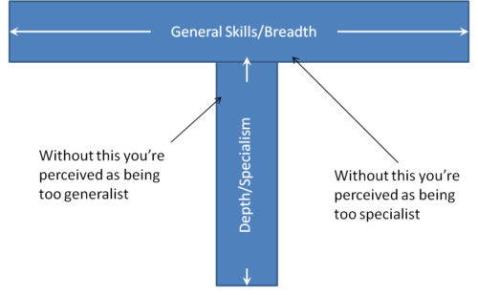
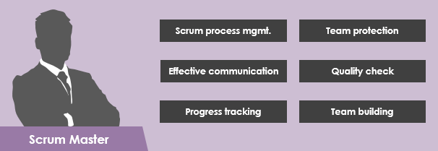

Team Structure
Cross-Functional teams
T-shaped skilled team members
Investment in Scrum Master
Overlap in onsite and offsite teams working hours

Slide 15
Contemporary Engineering Practices
Test first approach – Unit Testing & TDD
Test automation
Functional Tests
Regression
UI
Performance
Deployment automation
To facilitate up-to-date Ambassador env.
To facilitate micro releases (6 to 8 weeks)
Automated code analysis and coding guidelines enforcement
Continuous training and coaching

Slide 16
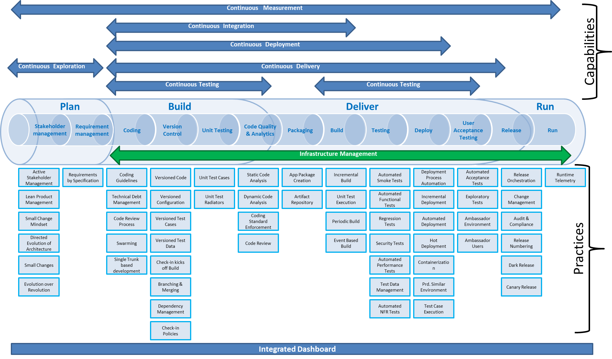
DevOps – Technical aspects
Purposeful omission of Security, Infrastructure, and Project Mgmt. to keep picture simple

Slide 17
DevOps – Organizational aspects
Dev and QA’s close collaboration
Planning for maintenance phase

Slide 18
Session Retrospective
Notes:
Stop Start Continue

Slide 19
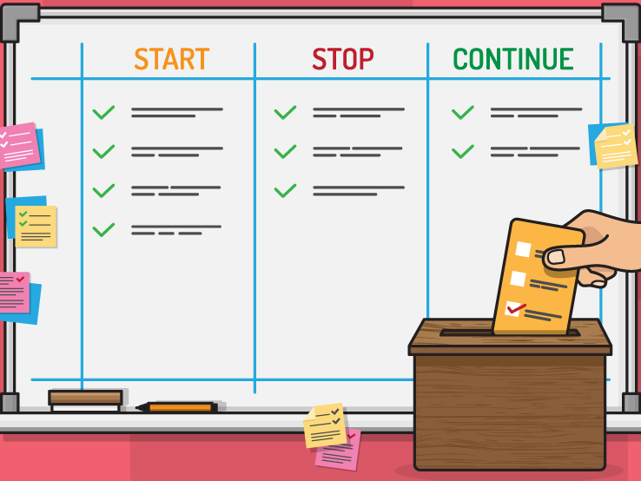
Session Retrospective
Notes:
Facilitator leads retro of training, one category at a time with action items at the end.
Create a safe and courageous space to tell the truth and grow.

